Slide 1
Shipments data download reporting for Supply Chain Management created with Brity RPA designer/orchestrator
Terry Lee

Slide 2
Disclaimer
This file does not contain any sensitive corporate data, specific process details, or information pertaining to any particular organization or individuals. Its purpose is to offer a high-level view of the generic steps taken by the authors to address a specific business problem. It serves as a scalable and adaptable template, enabling the replication of these steps for solving similar problems in future. Additionally, it includes technical details that can be partially or entirely reused for ongoing learning and improvement in future projects.

Slide 3
Business problem: Sharing the details of the products contained in the upcoming shipments is a vital process in supply chain management (SCM), any delay in providing to channel partners will lead to bullwhip effect, resulting in increased problems along the way. The supply chain management team have to download significant number of files from company system per each delivery order, up to 50 or more files a day including weekends, could take 30min – 1 hour compiling the files and send off to warehouse agent. This tedious nature of work can incur human errors such as missing files, and any problems with the system/network will further increase the lead time. This process while being crucial for business, doesn’t give any value to the employee in terms of experience and career growth.
The files downloaded and shared to warehouse agent are not organized, stored properly, and hence difficult to look back and find answers when clients asking for data files or information about history.
Solution: The required steps in generic form include: downloading multiple files from a system, ensuring all required files are properly downloaded, creating and maintaining the list downloaded and ensuring all but only the required files are shared to warehouse partner, and all these should be done every day including weekends for the data of previous date. This should be automated using Robotic Process Automation with unattended mode scheduled at 2am (no later than 6am) from a dedicated machine.

Slide 4
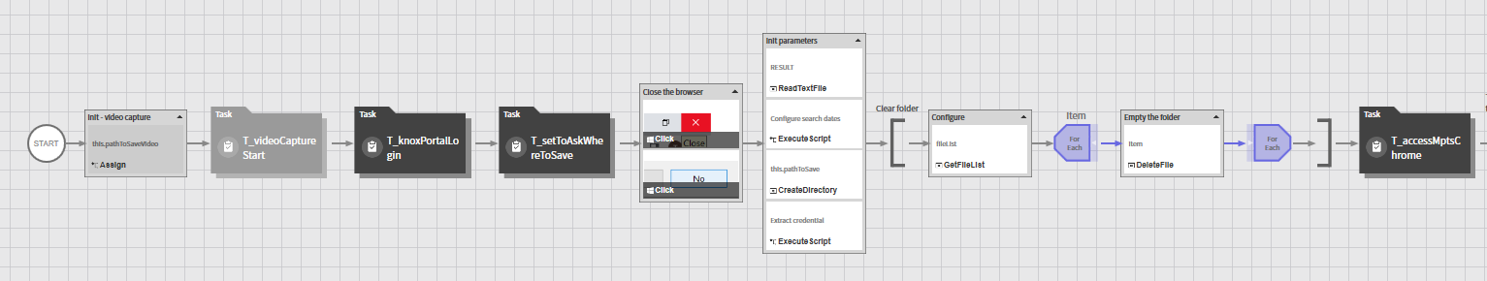
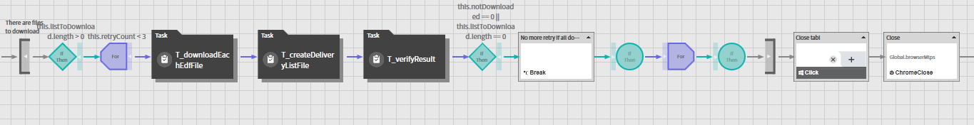
Process: DownloadEdfFile
JavaScript code to find the target date -
var date = new Date()
date.setDate(date.getDate() - 1) # target day is yesterday
this.targetDate = date.toString('yyyyMMdd')
var d = this.targetDate
this.dateToShow = d.substr(0, 4) + '-' + d.substr(4, 2) + '-' + d.substr(6, 2)
Task to view
Task to view
Task to view

Slide 5
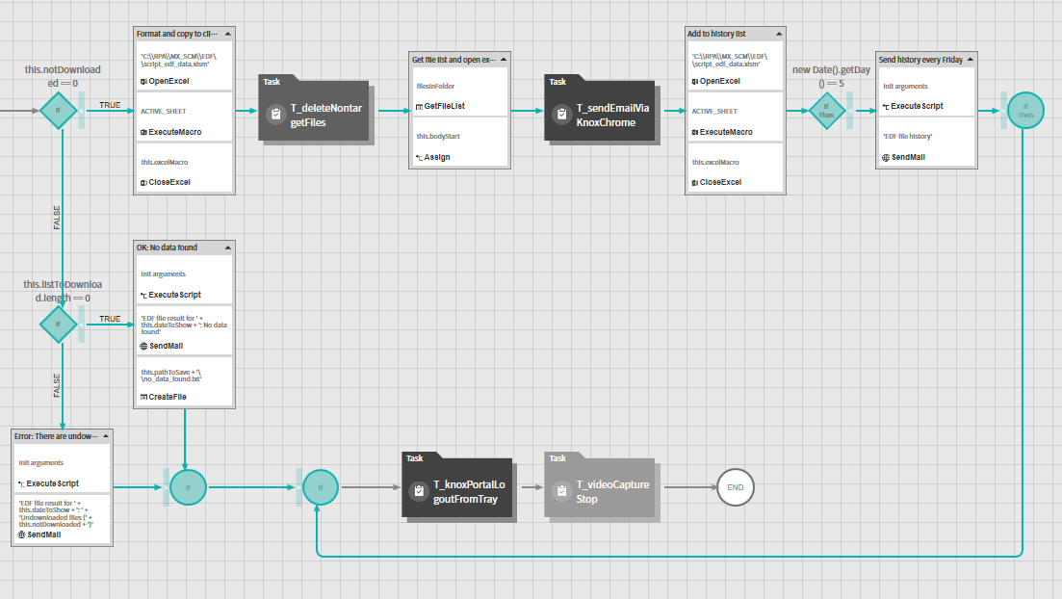
Process: DownloadEdfFile
Task to view
Code to view

Slide 6
Code to view – VBA to combine and format/copy
Public Sub FormatDataTargetFile(strPath As String)
Dim wshTgt As Worksheet
Dim wbkTmp As Workbook
Set wbkTmp = Workbooks.Open(strPath)
Set wshTgt = wbkTmp.Worksheets(1)
FormatData wshTgt
wbkTmp.Save
wbkTmp.Close
End Sub
Public Sub FormatData(wshTgt As Worksheet)
Dim cell As Range
Dim maxCol As Integer
With wshTgt
maxCol = .UsedRange.Columns(.UsedRange.Columns.Count).Column
.Range(.Cells(1, 1), .Cells(1, maxCol)).Interior.Color = DARK_BLUE
For Each cell In .UsedRange
cell.Borders.Color = GREY_BORDER
Next
.Columns("A:A").ColumnWidth = 3
.Columns("B:B").ColumnWidth = 12
.Columns("C:C").ColumnWidth = 18
.Columns("D:D").ColumnWidth = 5
.Columns("E:E").ColumnWidth = 5
.Columns("F:F").ColumnWidth = 5
.Columns("G:G").ColumnWidth = 5
.Columns("H:H").ColumnWidth = 16
.Columns("I:I").ColumnWidth = 16
.Columns("J:J").ColumnWidth = 33
.Columns("K:K").ColumnWidth = 52
With .UsedRange.Font
.Size = 9
.Name = "Arial"
End With
.UsedRange.CopyPicture xlScreen, xlBitmap
End With
End Sub
Const GREY_BORDER = 12566463
Const DARK_BLUE = 15849925
Public Sub AddToHistory(strPath As String)
Dim wbkTgt As Workbook, wbkSrc As Workbook
Dim wshTgt As Worksheet, wshSrc As Worksheet
Dim rngTgt As Range, rngSrc As Range
Dim rowTgt As Long
Set wbkTgt = Workbooks.Open(strPath & "\" & "edf_delivery_list.xlsx")
Set wshTgt = wbkTgt.Worksheets(1)
Set wbkSrc = Workbooks.Open(strPath & "\" & "list.xlsx")
Set wshSrc = wbkSrc.Sheets(1)
With wshSrc
Set rngSrc = .Range(.Cells(2, 1), .Cells(.UsedRange.Rows.Count, .UsedRange.Columns.Count))
End With
With wshTgt
rowTgt = .UsedRange.Rows(.UsedRange.Rows.Count).Row + 1
Set rngTgt = .Range(.Cells(rowTgt, 1), .Cells(rowTgt, 1))
End With
rngSrc.Copy
rngTgt.PasteSpecial xlPasteValues
Application.DisplayAlerts = False
wbkSrc.Close SaveChanges:=No
wbkTgt.Save
wbkTgt.Close
Application.DisplayAlerts = True
End Sub

Slide 7
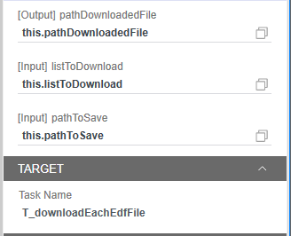
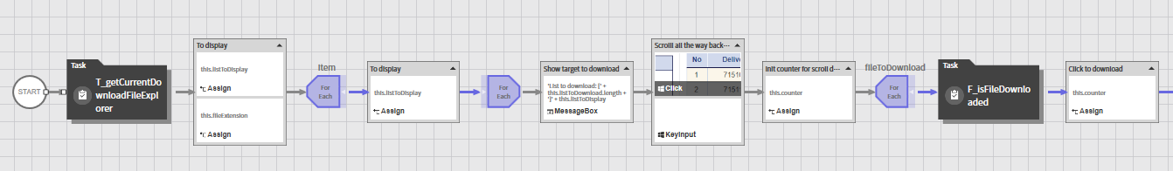
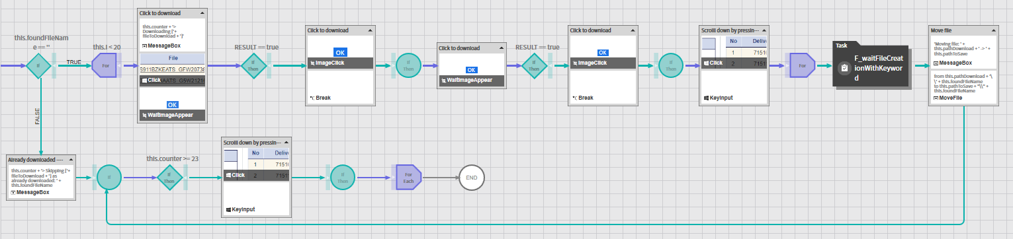
Task to view – T_downloadEachEdfFile
Function to view
Function to view

Slide 8
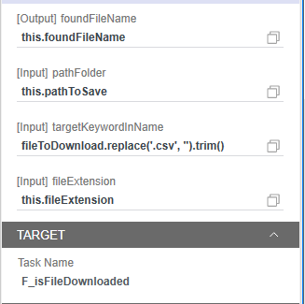
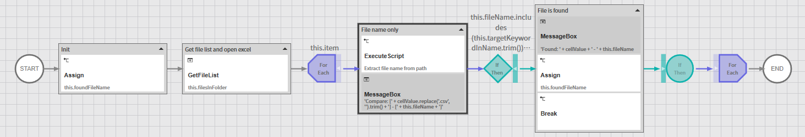
Function to view – F_isFileDownloaded

Slide 9
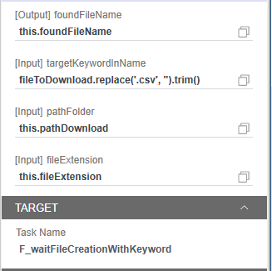
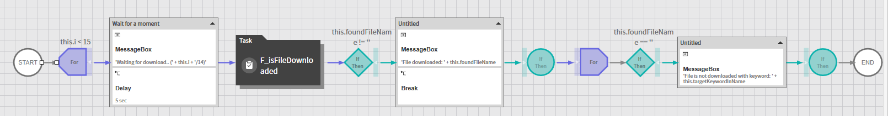
Function to view – F_waitFileCreationWithKeyword

Slide 10
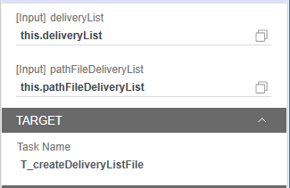
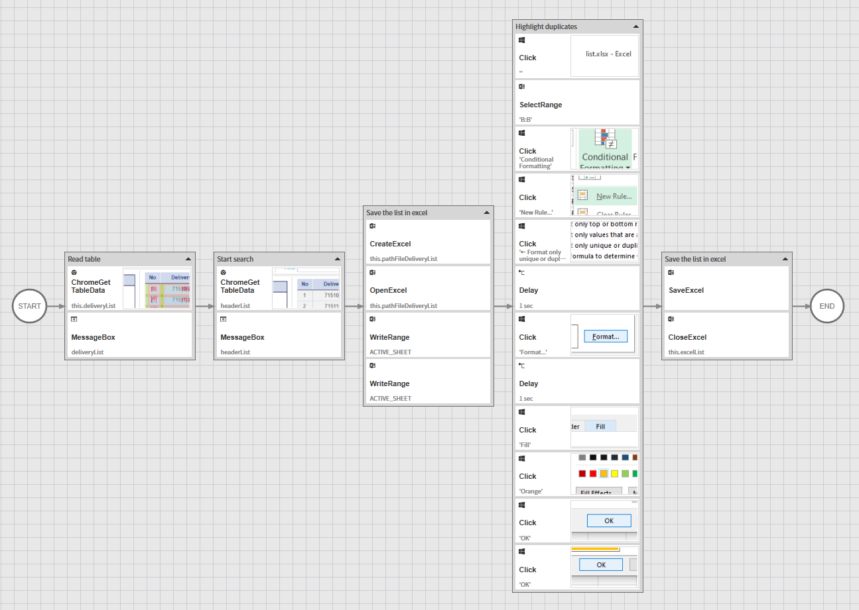
Task to view – T_createDeliveryListFile
Apply conditional formatting to highlight any duplicate entries from system
Read header and content from the table from browser
Write header and content into excel file

Slide 11
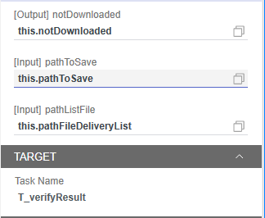
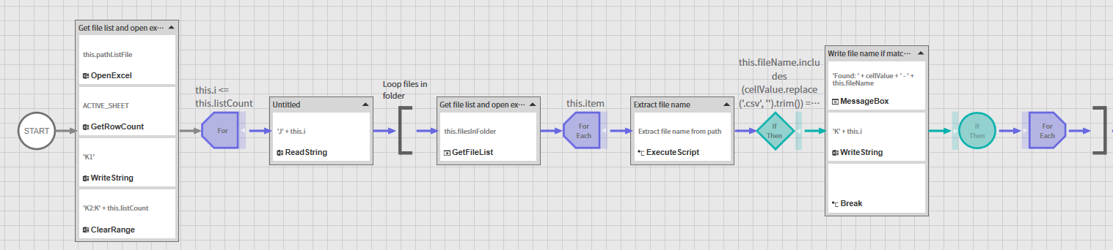
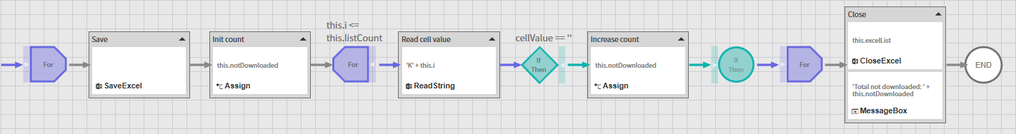
Task to view – T_verifyResult
JavaScript code to Extract file name:
var pos = this.item.lastIndexOf('\\')
this.fileName = this.item.substring(pos + 1)

Slide 12
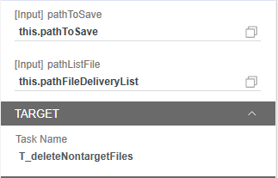
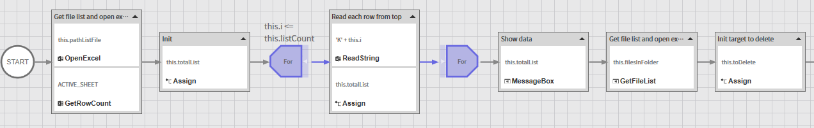
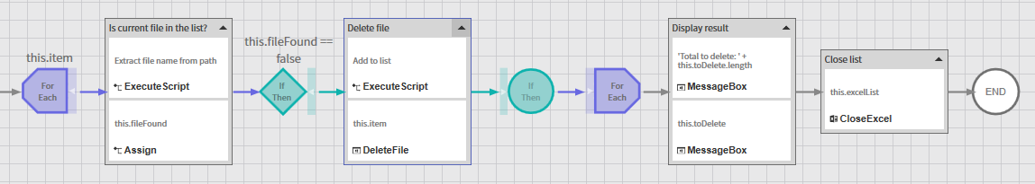
Task to view – T_deleteNonTargetFiles
Read excel file and form a string targetList contains all the files which should be in the folder
Delete current file, as not found from targetList
Read current folder and see if each file is included in the targetList string
var pos = this.item.lastIndexOf('\\')
this.fileName = this.item.substring(pos + 1)
fileFound = this.totalList.includes(this.fileName) == true

